Slide 1

MA 2016 Storm Activity

Slide 2
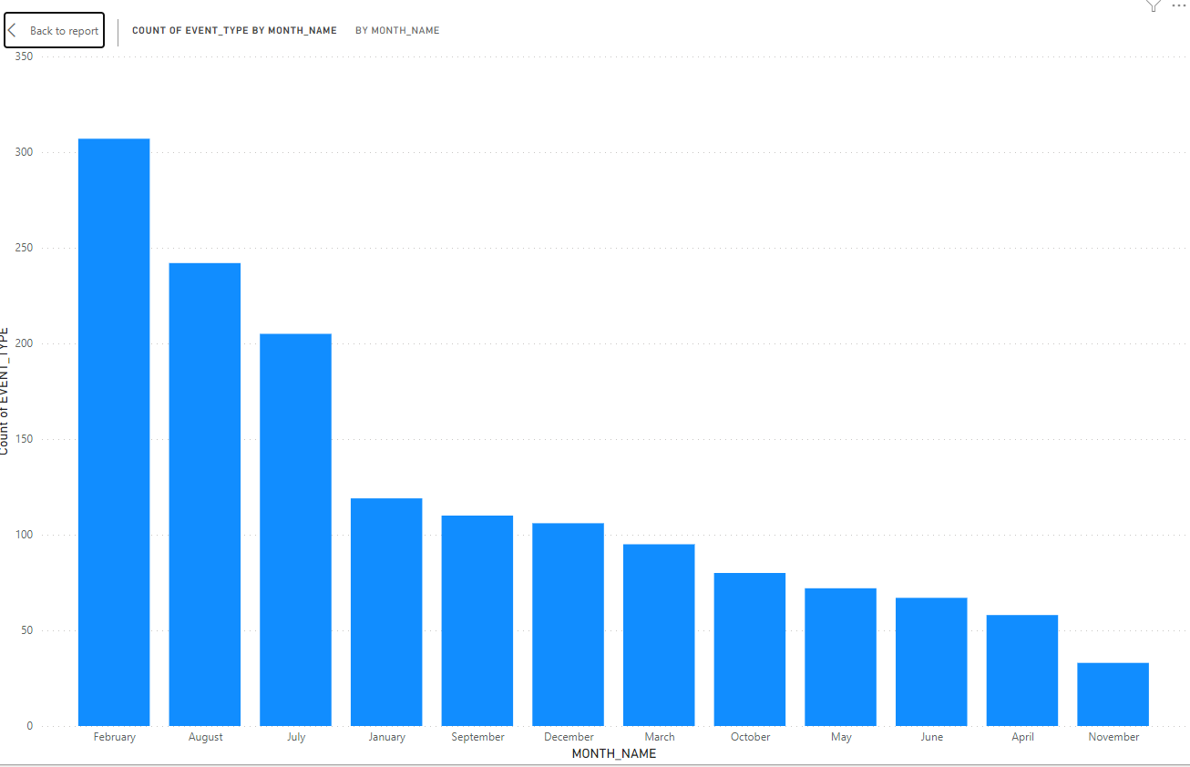
Most to least events by Month
Notes:
Simple bar graph depicting which months had the greatest number of storm events
Starts the discussion about what specific storm events make up any specific month
Have audience guess which event is most likely to occur the most in each month

Slide 3
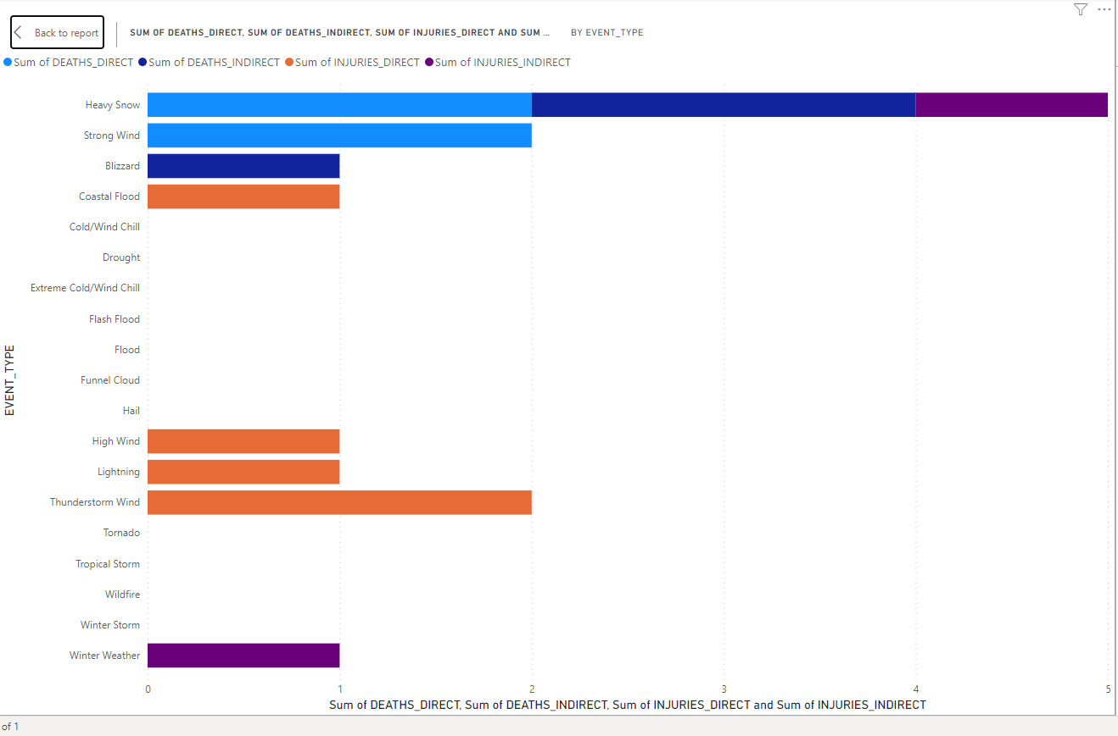
Deaths and Injuries by Event
Notes:
Categorical data on how many deaths or injuries occurred in each storm event.
Light blue – deaths direct, dark blue – deaths indirect, orange – injuries direct, purple – injuries indirect
Greatest number of deaths and injuries in heavy snow

Slide 4
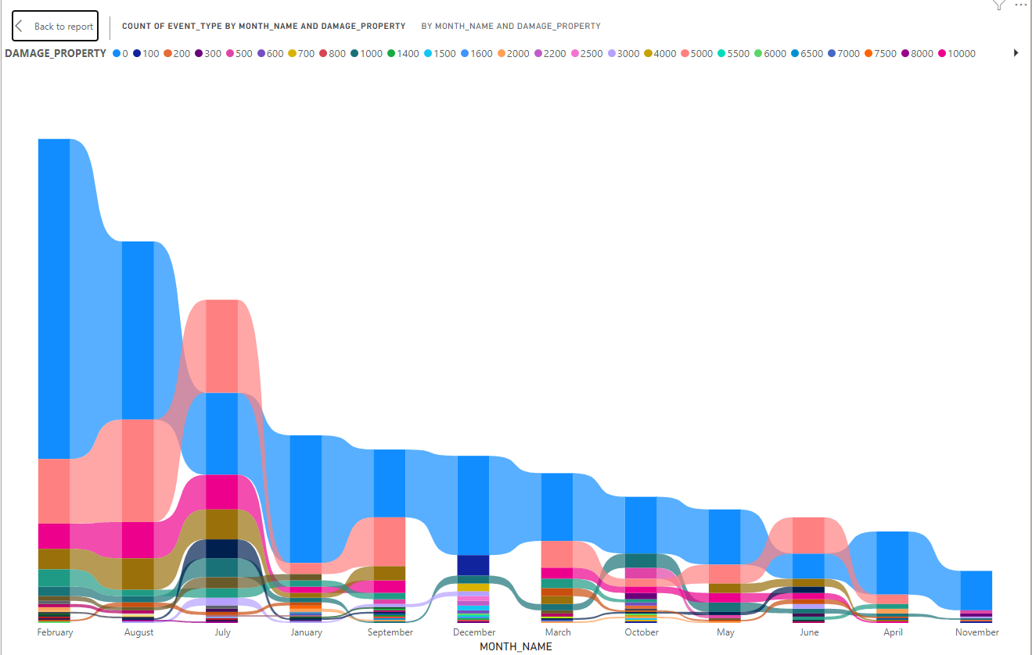
Fluctuations between activities by month
Notes:
Shows different levels of storm events by category within each month
Graph is depicted in descending order based on frequency for ease of access
Analyst should reconstruct graphs to show months in order (ie Jan, Feb, Mar, etc.)

Slide 5
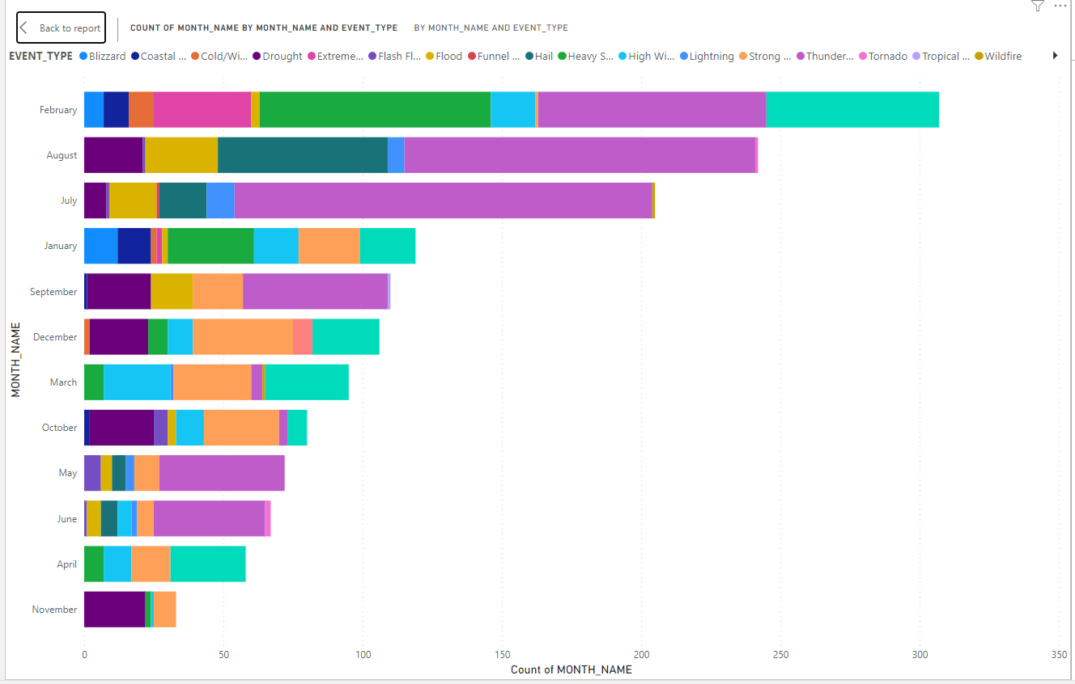
Event Breakdown by Month
Notes:
Another visual breakdown of storm events by category within each month
Use colored stacked bar graph in order to increase ease of access for audience
Thunderstorms are the most commonly occurring event

Slide 6
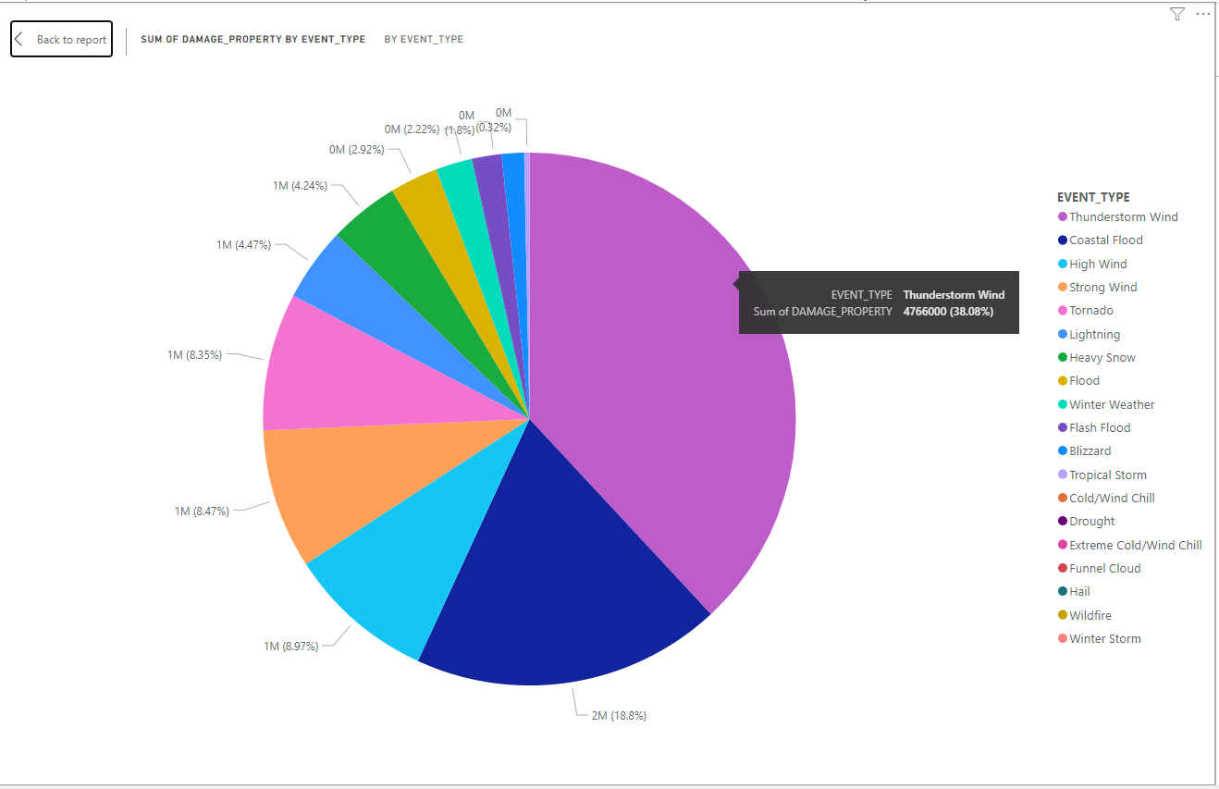
Breakdown of Damage by type
Notes:
Pie chart breaking down damage done to property by each event
Shows that thunderstorms cause the most damage by significant margin
Thunderstorms and Coastal floods make up over 56% of damage
State is well equipped for snowstorms but needs to improve response to electrical storms

Slide 7
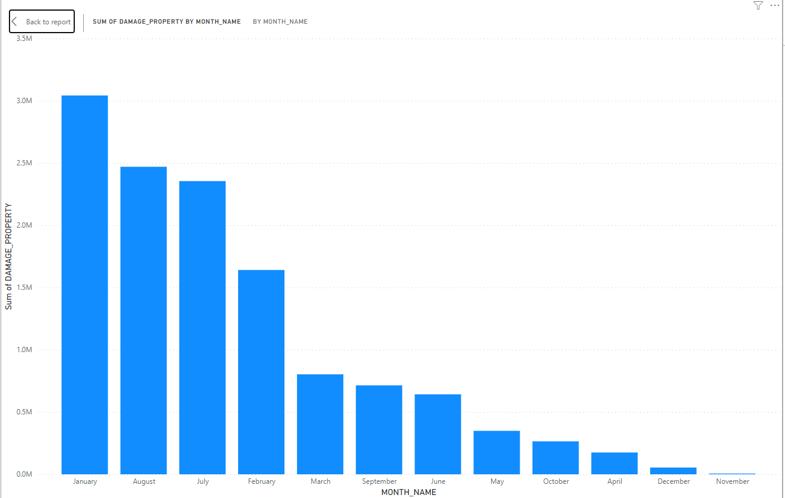
Most Destructive Months
Notes:
Moving on from the previous pie chart, we can see which months had the greatest cost to the state
January was the most expensive month while November barely had any cost to the State
August and July costs are similar, suggesting that improvements during the summer may be possible

Slide 8
Questions?

Slide 9
Contact Information
Benjamin Richwine
Richwine85@gmail.com
www.linkedin.com/in/ben-richwine
https://github.com/BRichwine/Projects

